Slide 1
CPSC 601 – Course Project
Machine Translation with NLP for cross-cultural communication
Md Abu Quwsar Ohi (30177909)
Sujesh Padhi (30199552)
Winter Term – April 2023

Slide 2
Agenda
Motivation
Methodology
Current Results
Discussion/Future Work
Notes:
Delivery
Engaging presentation with proper pace within the 5-7 minute time limit. Visual aids/slides used effectively.
Organization/Clarity
Ideas are presented in a logical order with effective transitions between major ideas. Presentation clear and concise.
Content
Required content covered in detail with a clear focus. Project is clearly well-developed with adequate background. Inclusion of visual aids to support material.
Participation
Provided comments to the groups that were assigned
Comments or questions were thoughtful and/or helpful for project improvements. Comments made on your own project were responded to.

Slide 3
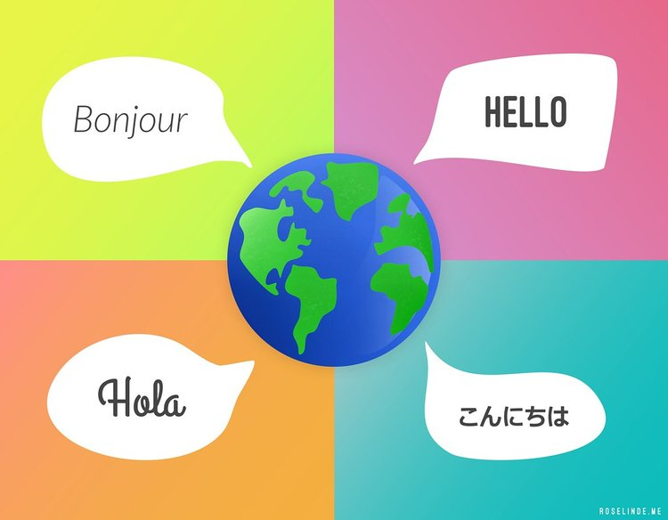
Motivation
Communication plays a major role in daily life
NLP deals with human language and machine interaction
Solving language-related problems such as language translation, sentiment analysis, and more.
Machine Translation (MT) is a popular NLP application that uses algorithms and statistical models to translate text from one language to another
NLP-powered machine translation –
can facilitate cross-cultural communication
promoting understanding
collaboration among people from different backgrounds

Slide 4
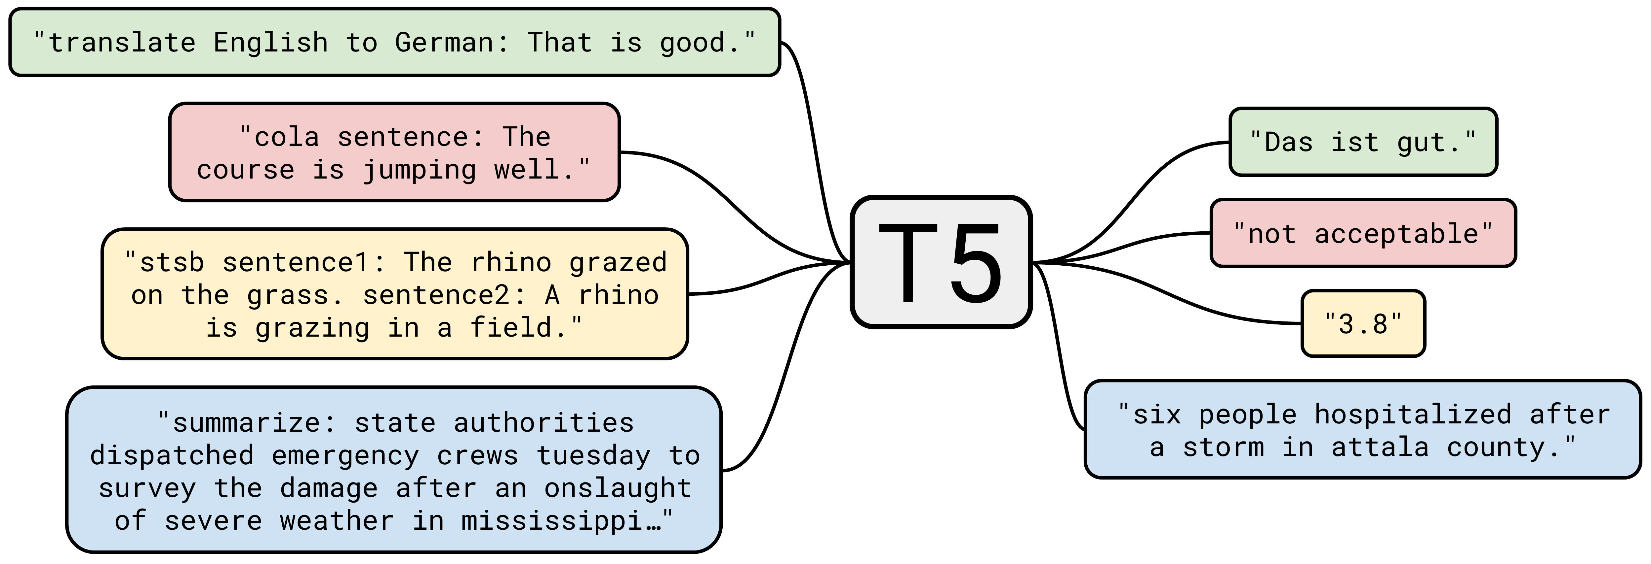
Methodology – Overview
Text-to-Text Transfer Transformer (T5) – A transformer-based encoder-decoder model trained on a diverse set of tasks, including language modeling, translation, summarization, and question answering
Training strategy – An unsupervised strategy followed by a supervised training strategy
Pre-trained on a large dataset Colossal Clean Crawled Corpus (C4)
Existing language mappings –
English to German
French to Romanian
Multi-language conversion capabilities
Capabilities of T5

Slide 5
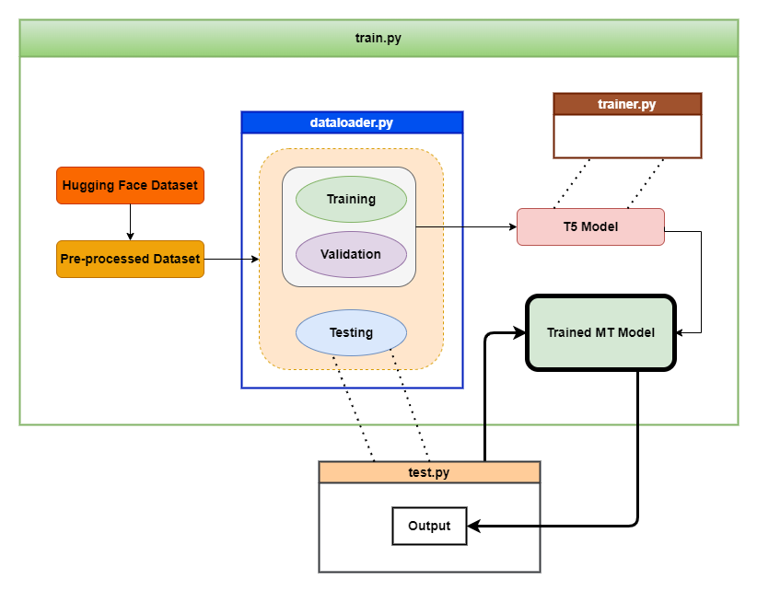
Methodology – Training Approach
Dataset - IWSLT 2017
Encoder and decoder has 6 blocks each of attention mechanisms
Froze all the blocks except the last 2 blocks of decoder
Has 60.5 million parameters; we used 16-bit precision numbers
Stochastic Weight Averaging for better generalization
 |  | TO
 |  | English | German | Italian | Dutch | Romanian | French
FROM | English | NA | X | X | X | X | X
 | German | X
 | Italian | X |  |  | X | X
 | Dutch | X |  | X |  | X
 | Romanian | X |  | X | X
 | French | X
Batch Size – 40
Epochs – 20
Learning rate – 10⁻⁴

Slide 6
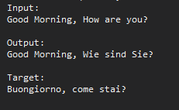
Current Results – Overview
English to German
INPUT
Good Morning, How are you?​
Pre-trained on English to German
OUTPUT
Guten Morgen, Wie sind Sie?
TARGET
Guten Morgen, wie geht es dir?
English to Italian
INPUT
Good Morning, How are you?
OUTPUT
Guten Morgen, Wie sind Sie?
German
No knowledge of Italian
TARGET
Buongiorno, come stai?

Slide 7
Current Results – Validation & Testing
Work in progress
English to Italian
INPUT
Good Morning, How are you?
OUTPUT
Buon mattino, come siete?
Bilingual Evaluation Understudy
TARGET
Buongiorno, come stai?
Notes:
The BLEU (Bilingual Evaluation Understudy) score is a number between zero and one that measures the similarity of the machine-translated text to a set of high-quality reference translations.

Slide 8
Discussion/Future Work
We have trained a single model that can perform multi-languages translation
Translation is fast and results are accurate (verified using google translator)
Additional hours of training is required for fine tuning
Include the scope of the training dataset to all possible language translations
Increase the blue-score with further training on a cluster with powerful GPUs
Implement into a chat-bot with real-time translation capabilities

Slide 9
Thank You

